Slide 1
Big Data Project:
Bank Account Fraud
Ava Cook
Econ 695 Spring 2023
17 April 2023

Slide 2
$8.8 billion
of American consumers’ money lost to fraud in 2022. (Vedova, 2023)
Notes:
According to the federal trade commission, American consumers lost almost 8.8 billion dollars to fraud in 2022.
This is up from 6.1 billion dollars in 2021, which was nearly double the 3.4 billion lost in 2020.
Fraud takes a variety of forms - for my project I focused on bank account fraud. I think that bank account fraud is especially troublesome because it reduces confidence in financial institutions.
A well-functioning financial system is imperative for a properly functioning economy. A lack of confidence in financial institutions can have major negative externalities on the economy.
Application: predictive classification model to help banks predict whether or not an application is fraudulent - bank security

Slide 3
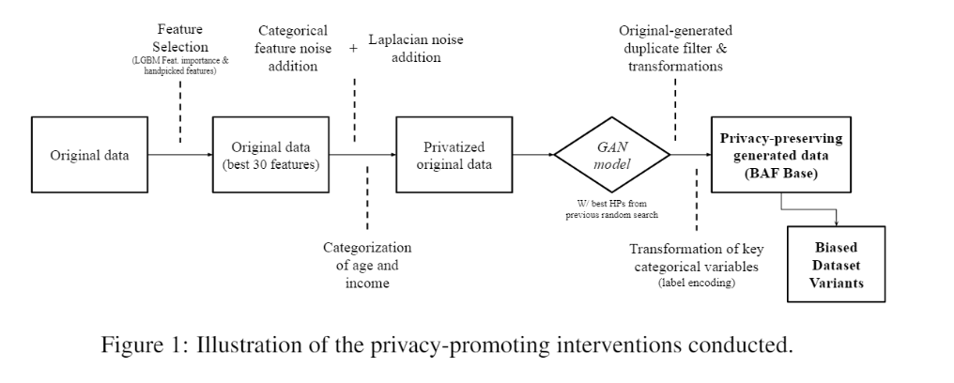
About the Data
From NeurIPS 2022
Designed for ML technique evaluation
Synthetic but simulates real-world fraud data
From BAF Dataset Suite Datasheet, by Jesus, et. al, 2022. Retrieved from https://github.com/feedzai/bank-account-fraud/blob/main/documents/datasheet.pdf.
Notes:
Found it on Kaggle, but the dataset is from NeurIPS 2022, which is an annual conference on machine learning.
The data itself is synthetic (meaning it is not raw real-world data) but it is made to simulate legitimate fraud data.
Can see the data creation process in this infographic - took original data, simplified and changed some variables, privatized data, re-encoded data, and modified traits of datasets for the variants.
Also worth noting that this dataset looks at a particular type of fraud called new account fraud - so this isn’t scams accessing pre-existing accounts. Instead, this dataset looks at fraudulent applications for new bank accounts.
The complete dataset was 573 megabytes, but included six smaller datasets. There is one base dataset and five variants on the dataset with different statistical properties. I will use base dataset and Variant V, which had better separability in the training data.
The original dataset has 1 million rows and 32 variables.
After a preliminary clean, the base dataset had about 195,000 observations of 32 variables.

Slide 4
Financial
Application
Institutional
Personal
Computer
Personal
credit_risk_score
has_other_cards
income
intended_balcon_amount
payment_type
proposed_credit_limit
device_distinct_emails_8w
date_of_birth_distinct_
emails_4w
device_os
email_is_free
foreign_request
keep_alive_session
name_email_similarity session_length_in_minutes
source
velocity_24h
velocity_4w
velocity_6h
device_fraud_count
current_address_months_count
customer_age
days_since_request
employment_status
housing_status
month
phone_home_valid
phone_mobile_valid
prev_address_months_
count
zip_count_4w
bank_branch_count_8w
bank_months_count
Variable of interest:
fraud_bool
Notes:
Key variables: fraud_bool - a Boolean vector which showed whether or not the account in the case was fraudulent.
Information on address, email, and zip code. Can use these as explanatory variables to predict whether or not an account is fraudulent (e.g. address changes a lot - may be a sign of a fraudulent account.)
Financial variables - income, credit plan type, amount transferred to bank account.

Slide 5
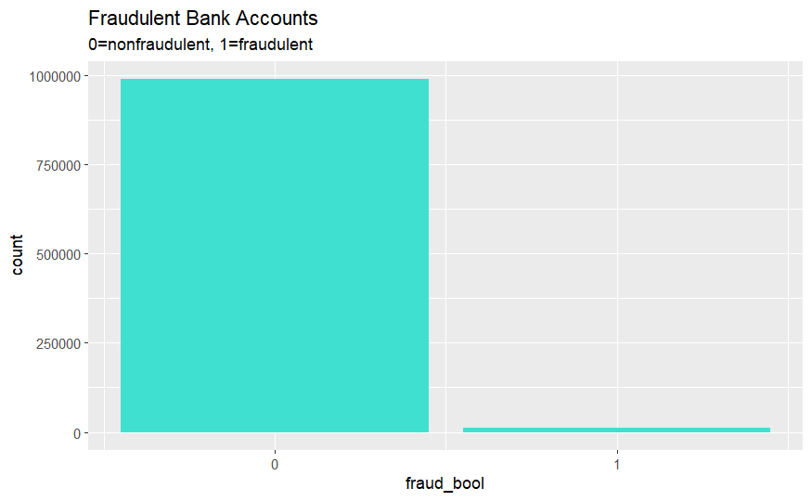
Notes:
Working with a very unbalanced dataset - only about 1.1% of cases are fraudulent. Thankfully I do have the million rows to work with so I will have approximately 10,000 fraudulent cases.

Slide 6
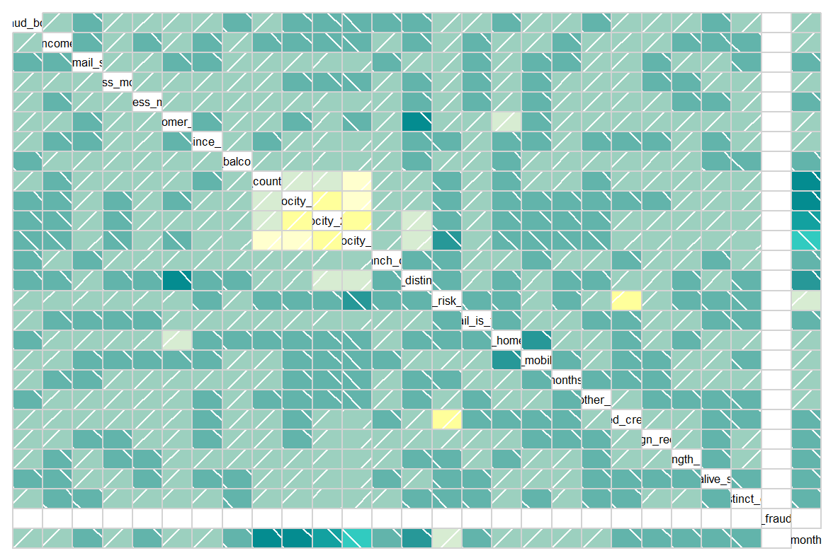
Notes:
Heatmap for variables
Turquoise is for negative correlation
Yellow is for positive correlation
Can see that there aren’t many strong linear dependencies between variables (which is a good thing.)
The strong positive correlations that you see here and here (yellow) are pretty easy to explain.
Large patch in the upper left - these variables are all measurements of the velocity of bank applications over different periods of time. Makes sense that they would be highly correlated because 8 hr velocity measurement is going to be related to the 24 hr velocity measurement.
The other yellow boxes here are relationship between credit risk rating and proposed credit limit - credit risk and credit limit are certainly related, so this makes sense.
Dark turquoise box in the center about a quarter of the way down - negative relationship between customer age and date of birth distinct emails. Not a very strong correlation, but kind of makes sense. Date of birth distinct emails is the count of the number of applicant emails for a given birth date. Since young people less likely to have a bank account, would expect fewer emails to be in the bank system for recent birthdates. Again, since this is a weak correlation I don’t think this should be too much of an issue.

Slide 7
My Analysis
Run with Base dataset
and again with Variant V
1. Training and Test Split
80% training, 20% test
2. Model Selection
LASSO
3. Classification: Fraud or Not?
Binary outcome variable
Logistic Regression, LDA, QDA, Naive Bayes
4. Cross-validation
K-fold CV with K=5, Split-Half CV
Notes:
195,000 observations, approx. 1% fraudulent => approx 1950 fraudulent cases out of training and test sets. If test set is 20% of observations, would expect roughly 390 fraudulent cases predicted for the test set. Wanted to guesstimate these outcomes because data is very unbalanced (=> there is a concern that the model would predict non-fraud for all cases.)
Since there is a substantial number of fraudulent cases for the model to predict, the unbalanced nature of the data shouldn’t interfere too much.
LASSO for model selection - tried Ridge, but the model was very complex (31 explanatory variables). Small test MSE but many variables. I wanted to go for a more parsimonious model.
Instead used LASSO. At first LASSO too parsimonious - only included 1 explanatory variable. Tried with a smaller lambda (which I identified with _____)
Binary classification problem - looking at the fraud_bool variable as response variable, which can only have 2 outcomes (fraud or not)
I decided I would like to try four different methods for binary classification problems to see which performs best with this dataset.
I’ll be using logistic regression, LDA, QDA, and Naive Bayes.
For cross-validation I will be using k-fold cross validation with k=?
Since my dataset is already pretty big I won’t be using bootstrap.
In the same vein, leave one out cross validation would be very computationally intensive.
Will try with Split-Half CV, but that may not be any more informative than the K-fold CV.
Will do this analysis for Base dataset - identify best performing classification method. Then will repeat for Variant V, which has better separability. I am curious to see whether the best performing classification method varies between the two datasets.

Slide 8
Initial Findings and Difficulties
Even with LASSO, obtain a complex model
Unbalanced data → Can have high prediction accuracy even when the model only predicts non-fraud
Unbalanced nature of data & data cleaning
Fraudulent cases are more likely to have missing information → omit.na() will proportionally drop more fraud cases
fraudstatclean <dbl> | fraudstatunclean <dbl>
0.002418999 | 0.011029
Notes:
LASSO - still obtain a complex model. Only dropped 2 variables. Model therefore 30 variables.
Unbalanced data => could have model that only predicts all non-fraud cases and still obtain a very high prediction accuracy. (e.g. model using cleaned data that predicts all nonfraud would have a 99.757% accuracy on the training data.) Really working to raise that accuracy on the margin.
Data cleaning - doing a simple omit.na() is going to drop proportionally more fraud cases. This is because fraudulent cases are more likely to have missing information.
Can see in the table I included here - the statistic on the left is the percentage of fraudulent cases if I drop all NAs in the dataset. The statistic on the right is the percentage of fraudulent cases if I keep in cases with NAs.
Would prefer to have the larger percentage of fraudulent cases (like in the dataset without NAs) because that will give me more data to work with and will really help with my model’s predictive accuracy.
Something that I’ll be addressing - seeing if there’s a way to calculate even with NAs in or seeing if there’s a way to replace NAs with a value that would still allow me to do calculations properly.

Slide 9
Works Cited
Iacurci, G. (2022, February 22). Consumers lost $5.8 billion to fraud last year - up 70% over 2020. CNBC. Retrieved April 24, 2023, from https://www.cnbc.com/2022/02/22/consumers-lost-5point8-billion-to-fraud-last-year-up-70percent-over-2020.html
Vedova, H. (2023, February 23). New FTC data show consumers reported losing nearly $8.8 billion to scams in 2022. Federal Trade Commission. Retrieved April 24, 2023, from https://www.ftc.gov/news-events/news/press-releases/2023/02/new-ftc-data-show-consumers-reported-losing-nearly-88-billion-scams-2022

Slide 10
Thank you!

